Slide 1
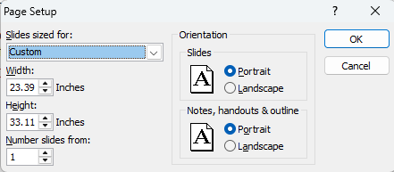
17th International Conference on Advanced Technologies, Systems and Services in Telecommunications – TELSIKS 2025
PAPER TITLE
Petar A. PETROVIĆ and Petar B. PETROVIĆ
POSTER PRESENTATION
For poster presentation, a 1m x 1m board will be provided. Standard format A1 (594 mm x 841 mm) of the poster is the most acceptable.
The Secretariat will provide the pins or tape for poster mounting.
Posters should be legible from a distance of 1-2 meters.
The recommended font sizes are: 30-40 mm for title, 20-30 mm for names of authors, 15-20 mm for headings and 10-15 mm for text.
Clarity and brevity are very appreciated.
Authors are requested to set up their posters well in advance of the starting session time and must be present throughout the whole session.
This is a template !
Customize it to fit your work!
IMPORTANT SETTINGS for preparation of the poster
Design/Page Setup
POSTER PRINTING !
Print poster in the format
A1 (594 mm x 841 mm)

